Slide 1
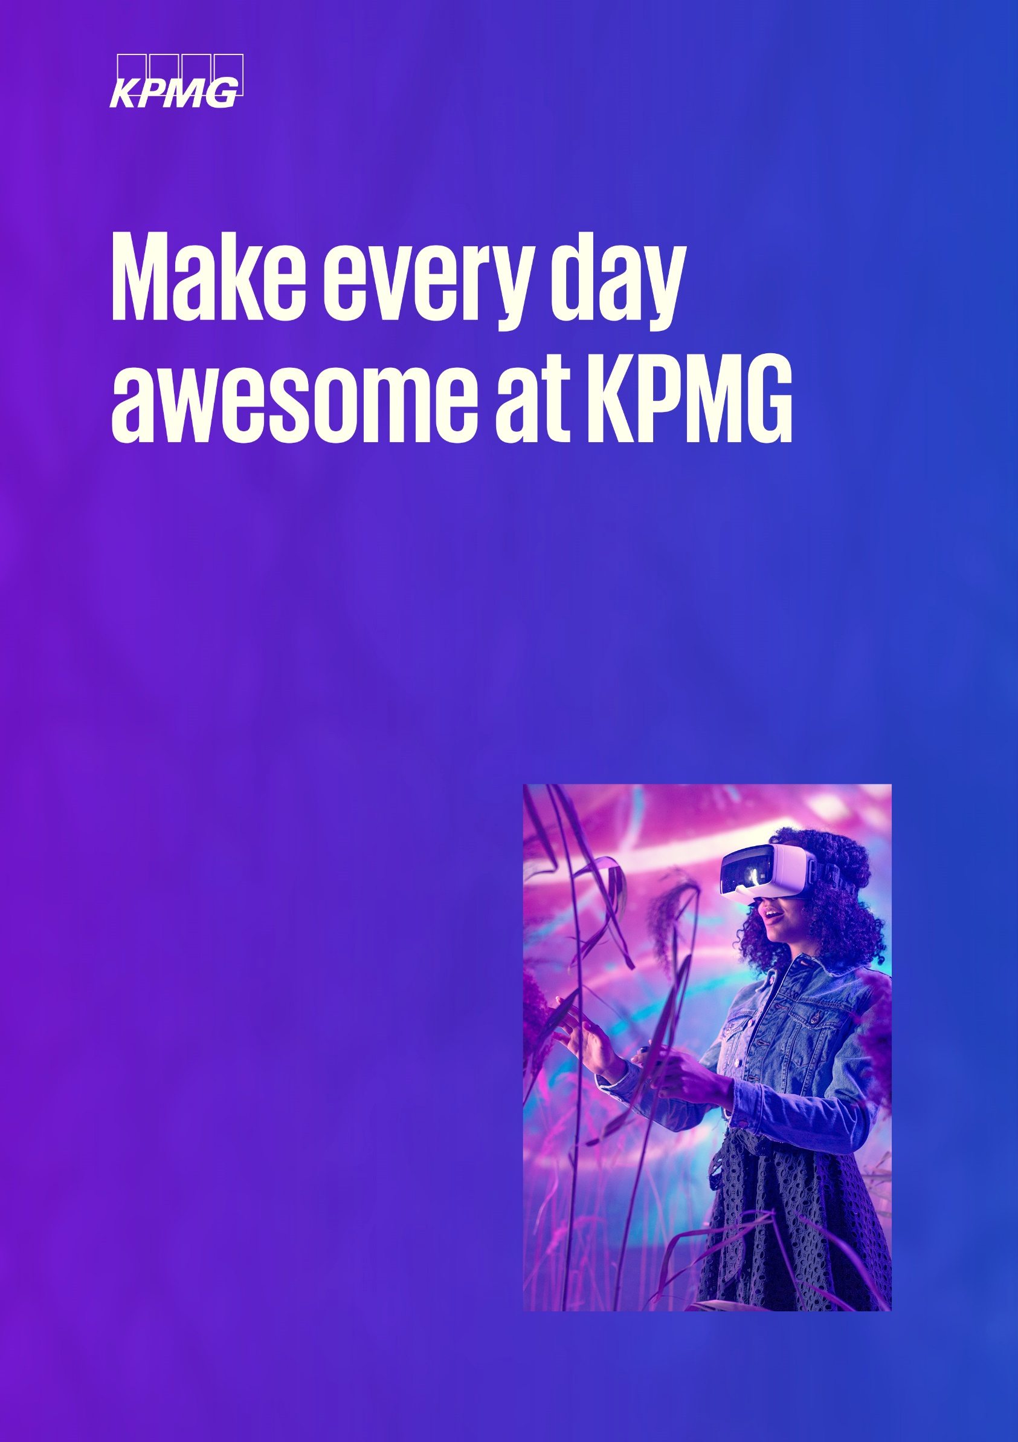

Job title:
Associate Consultant / Consultant
Business Unit: Consulting
Service Line: Customer Advisory
Location: Bangalore, Pune

Slide 2

About us
Job details
Proposed designation
Associate Consultant / Consultant
Role Type
Individual contributor
Reporting to
Assistant Manger
Geo to be supported
US/UK/ROW/Across geos/Other
Work timings
General / Based on client requirements
The Consulting business at KPMG Global Services (KGS) is a diverse team of more than 6400 professionals. We provide consulting services to KPMG Firms worldwide to support the business transformation journeys of clients across industries. Our colleagues help clients explore potential obstacles to change and collaborate on critical decisions that can deliver real value to their businesses.
Through your work, you’ll build a global network and unlock opportunities that you may not have thought possible with access to great support, vast resources, and an inclusive, supportive environment to help you reach your full potential.
Roles & responsibilities
Execute Customer Advisory projects with a focus on leveraging the Seismic platform for sales and marketing transformation.
Conduct end-to-end assessments to transition from 'as-is' to 'to-be' states, focusing on content management and personalization in Seismic.
Perform in-depth analysis and interpretation of clients' use of Seismic to identify optimization opportunities and develop actionable insights.
Develop strategic recommendations for improving sales content effectiveness using Seismic, creating business cases and implementation roadmaps.
Collaborate with internal teams, including technology professionals and Seismic stakeholders, to ensure effective delivery of services.
Provide support to clients in executing recommended solutions on Seismic, including change management, communications, training, and project management.
Communicate effectively with global stakeholders, demonstrating expertise and delivering solutions tailored to client needs.

Slide 3
This role is for you if you have the below
Educational qualifications & Work Experience
MBA in Finance from Tier 1 / 2 College
Overall experience of about 3- 9 Years
Experience in using Seismic platform for sales enablement or content management is highly desirable.
Strong customer service orientation and relationship management skills.
Come as you are
at KGS
As a firm, we are deeply committed to diversity, inclusion and equity at our workplace. We offer a safe and inclusive environment built on trust, where all our colleagues can bring their authentic selves to work and know that their uniqueness is valued.
We prohibit unfair treatment of applicants and employees and discrimination on any ground, including but not limited to, caste, religion, color, ancestry, marital status, medical condition, sex, gender identity and/or expression, sexual orientation, age, nationality, cultural origin, family or parental status, defense veterans, physical, mental or sensory disability or any other status or characteristic protected by applicable Indian laws and regulations.
Preferred technical & functional skills
Proficiency in the Seismic platform, including content personalization, data analysis, and usage tracking.
Experience in customer experience management and customer journey design using Seismic.
Familiarity with conducting trainings and workshops to enable clients and staff to effectively use Seismic.
Background in consulting within sales, marketing, or e-commerce transformation, preferably in a Big4 environment.
Ability to optimize processes and costs using data-driven insights within Seismic.
Key behavioral attributes/requirements
Excellent business communication skills
Other skills include effort estimation, pre-sales support, project planning, conduct trainings for clients / internal staff
Ability to build strong business relationship with internal and external stakeholders
Strong verbal, written and data presentation skills
Other information
Interview process: expected two to three rounds of interviews
Does the job role involve travelling: Travel when necessary
Does the busy season apply to this role?: No
KPMG Global Services (KGS) India is a strategic global delivery organization that works with over 50 KPMG firms to provide them a range of Advisory, Tax and Audit support services.
The firm operates from eight locations in India — Bengaluru, Gurugram, Hyderabad, Mumbai, Kochi, Noida, Pune and Kolkata.

